Slide 1
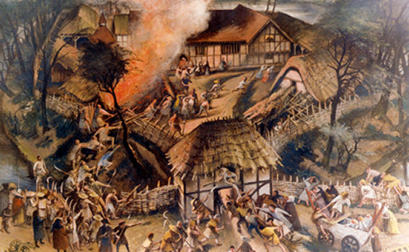
What really happened during the Peasants Revolt?
CC p. 142-143

Slide 2
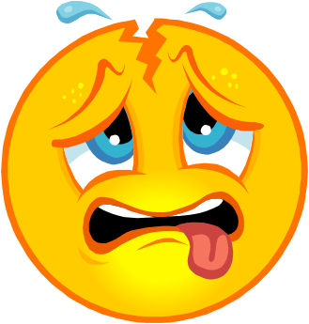


Starter
Your secret spy identity has been uncovered. You have been captured by the leader of the Peasant’s revolt, Wat Tyler. Here, you have overheard their next moves. How will you let the King know without getting into further trouble?? You are to write down your plan, but be prepared because the walls have ears!

Slide 3

What really happened during the Peasants Revolt?
By the end of the lesson you will be
able to ...
Identify what happened at the meeting at Smithfield
Explain the different opinions about what happened
during the meeting
Create a newspaper article about the event.
Write down the underlined words in bold!

Slide 4
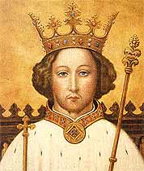
The Meeting at Smithfield
On 14th June Richard II met the rebels at Mile End. Tyler asked the king to grant all villeins their freedom and pardon the rebels for their actions.
Richard II met the rebels again on 15th June at Smithfield. Tyler rode to the king and repeated the peasants’ demands. The Mayor of London, William Walmouth lunged at Tyler and wounded him. Tyler was struck down and killed by a royal knight. Richard II left the scene fearing a riot. The peasants were bewildered, they began to drift home, believing that they were pardoned. The Revolt had ended.

Slide 5
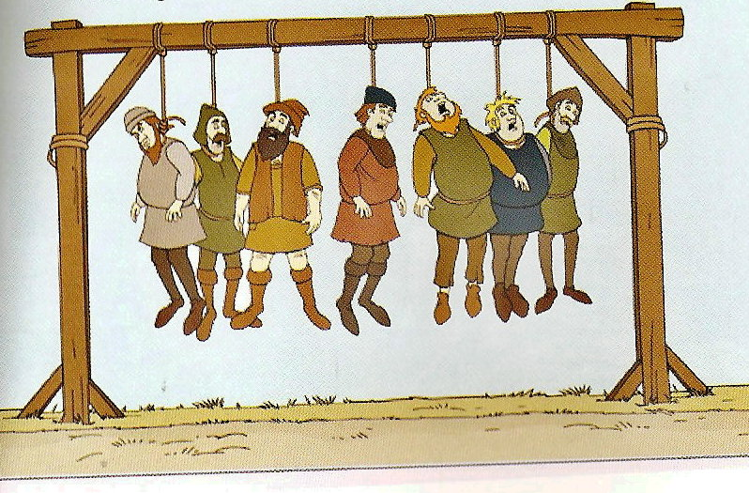
BUT Richard II set about punishing the rebels, breaking all the promises he had made. John Ball was hanged, his body quartered and sent around England for everyone to see. A further 150 peasants were hanged.

Slide 6
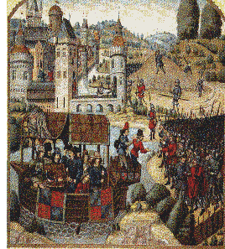
The meeting at Smithfield

Slide 7


What were the peasants’ demands?
What happened to Wat Tyler when he met King Richard at Smithfield?
Ext: read sources 9 and 10 on page 142. How are these two accounts different?

Slide 8

What are the different views of the Smithfield meeting?
“You wretched men, who seek equality with the lords, are not worthy to live. You will remain in bondage, not as before but harsher.”
King Richard speaking to the peasants after the revolt
“Once the rebels were safely dispersed, the King broke all the promises he had made. All over Essex and Kent, rebel leaders were rounded up and hanged.”
From a recent history book

Slide 9
“The commons were arrayed in battle formation in great numbers. Tyler dismounted, carrying his dagger. He called for some water and rinsed his mouth in a very rude disgusting fashion in front of the King.
Tyler then made to strike the King’s valet with his dagger. The Mayor of London tried to arrest him, and because of this Wat stabbed the Mayor with his dagger in the stomach. But the Mayor as it pleased God, was wearing armour, and drew his cutlass and gave Wat a deep cut on the neck, and then a great cut on the head.”
Written by a monk in York in 1399

Slide 10
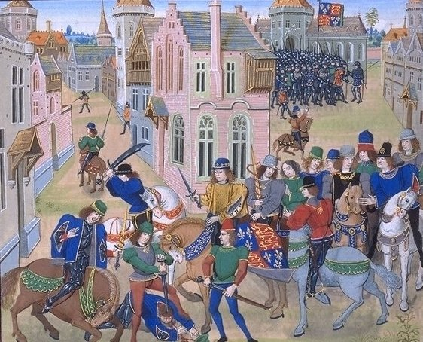

3. How do interpretations of the Smithfield meeting differ? Refer to the sources in your answer.

Slide 11


Create a newspaper front page for the 16 June 1381 that describes the events of the previous day. Your newspaper supports the king, so make sure your writing is one-sided. Think of a good headline, use quotes from the sources on pages 142-143 and include a picture of the scene.

Slide 12
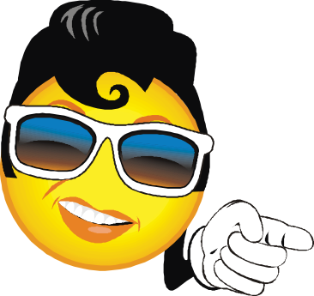
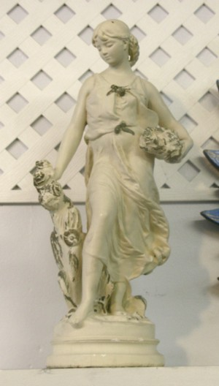
Plenary: A statue has been commissioned to commemorate the bravery of the peasants. What would you write as an inscription on the statue?

